Slide 1
H & j bath and body works business analysis and recommendations

Slide 2
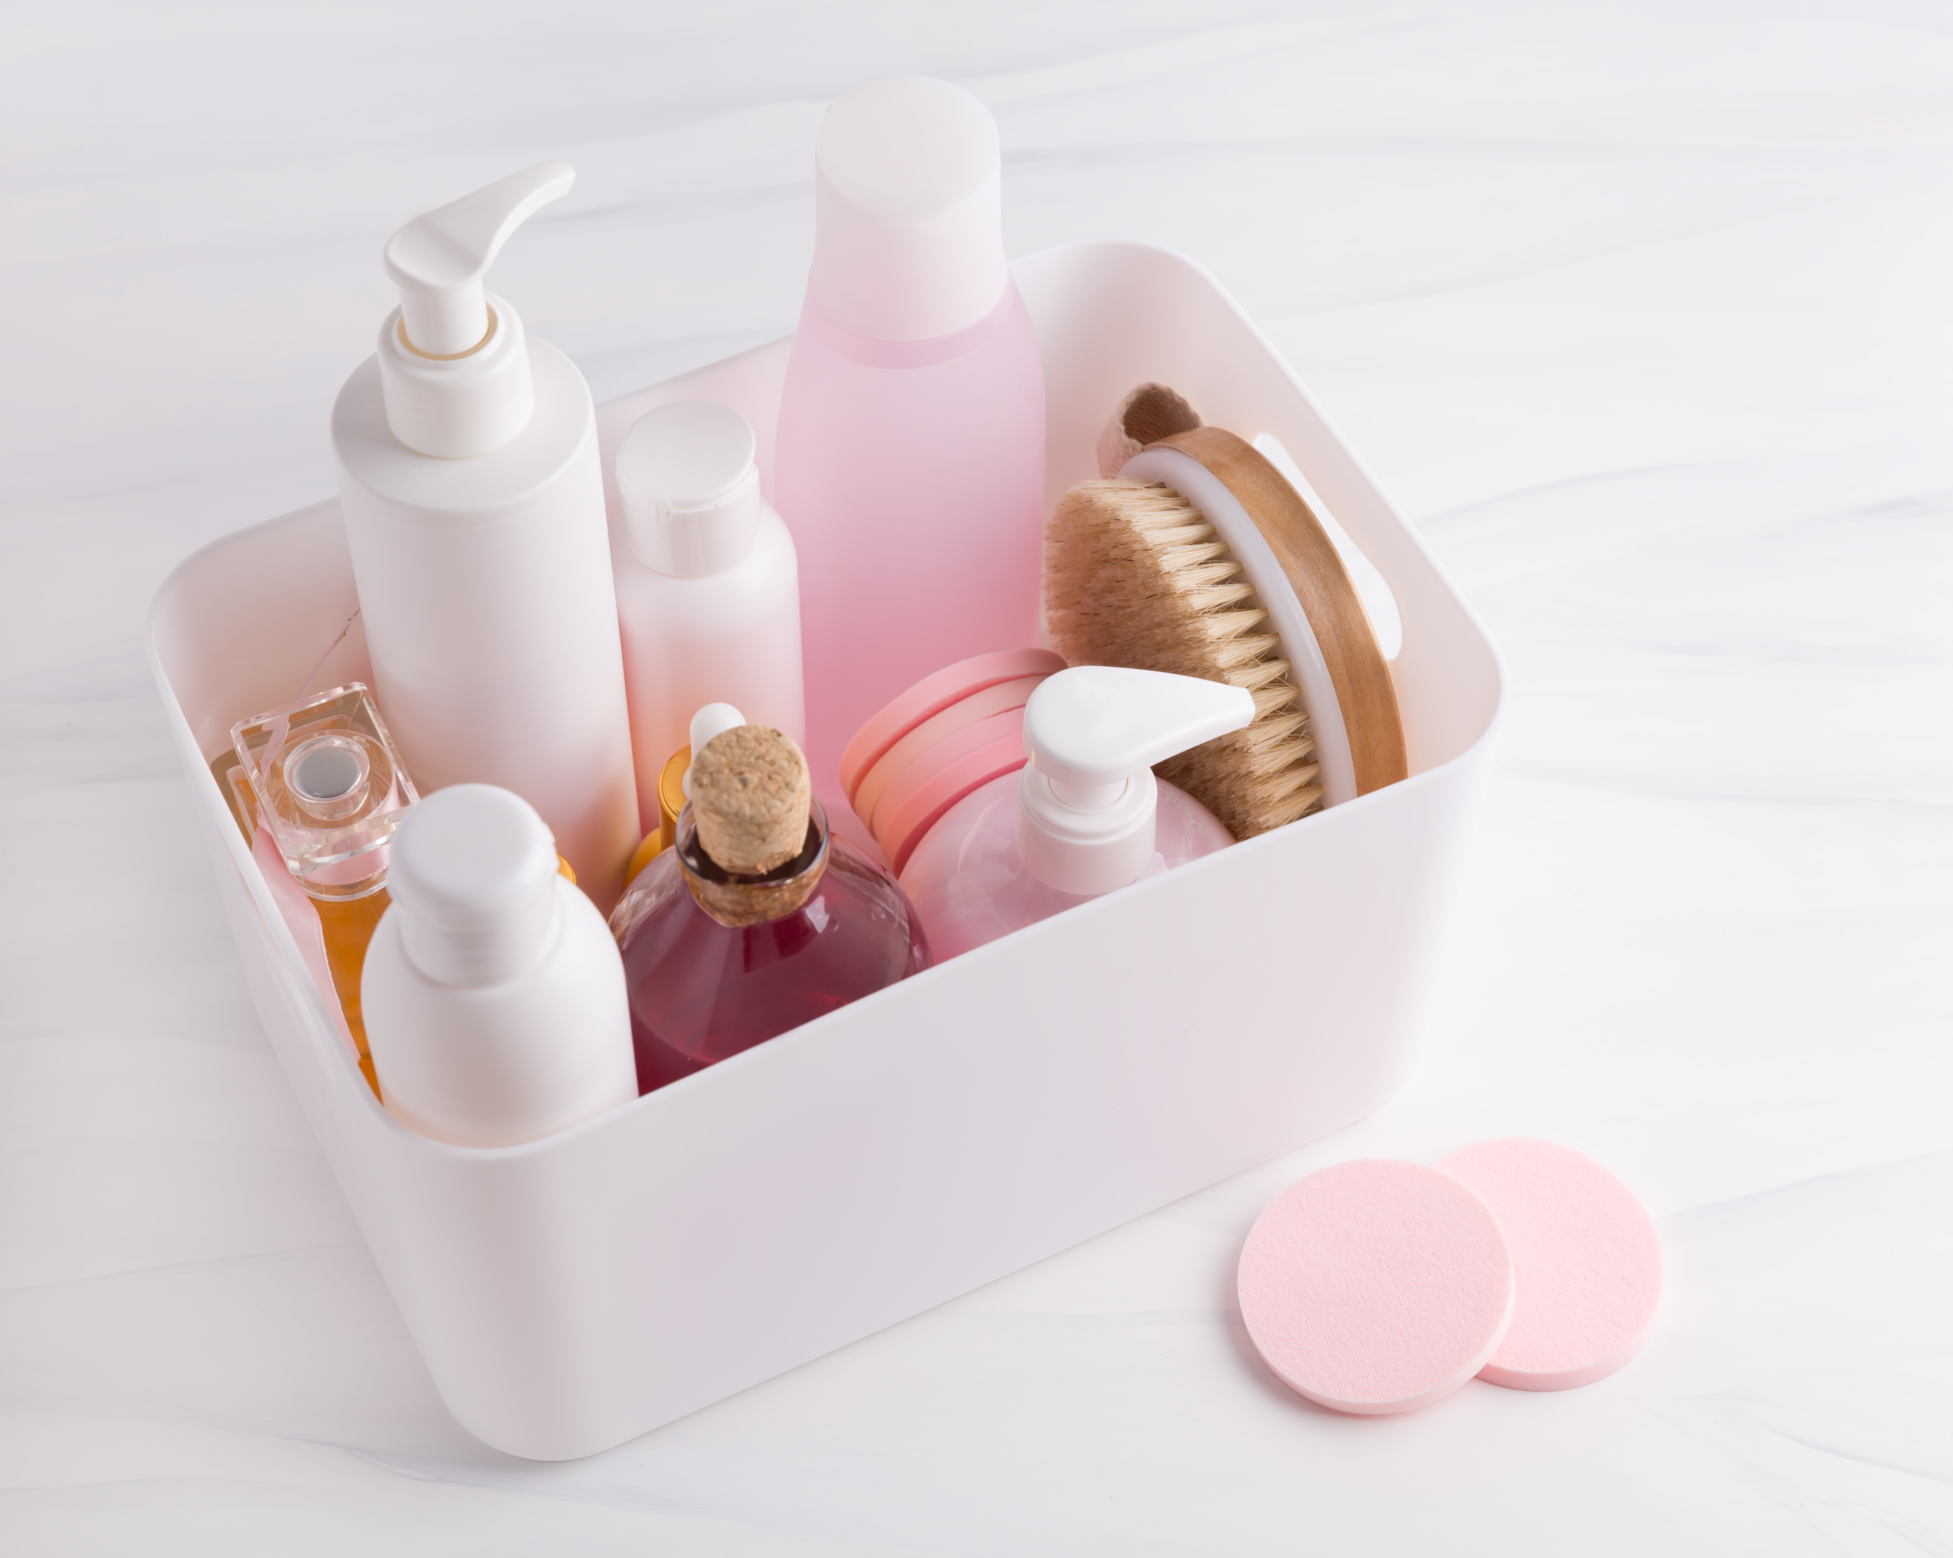
Project introduction
Good [morning/afternoon/evening] everyone,
My name is Joseph, and today I am honored to present an in-depth data analysis project centered on H & J Bath and Body Works.
The primary objective of this project was to figure out the profit and loss of this shipment and to achieve a comprehensive understanding of the business's performance, with a keen focus on profitability and sales trends. Through this analysis, I aim to provide actionable insights that will drive strategic decision-making and foster sustainable growth.

Slide 3

Project Scope and Objectives:
1.Calculate Shipment Profit:
Determine the total profit generated from the current shipment.
Determine the overall profit or loss made by this shipment
2.Identify High-Profit Products:
Analyze and identify products that yield the highest profit margins.
3Analyze Sales Performance:
Evaluate which products sell quickly and which ones do not, providing insights into sales velocity.
4Identify Loss-Making Products:
.Pinpoint products that are incurring losses and assess their impact on overall profitability.
5.Identify best selling products with the highest profit
6.Provide Strategic Business Recommendations:
Develop actionable recommendations to expand the business and enhance profitability.

Slide 4

Objective 1: This Shipment Profit

Slide 5

PRICE COMPARISON BETWEEN THE SELLING PRICE AND BUYYING PRICE

Slide 6
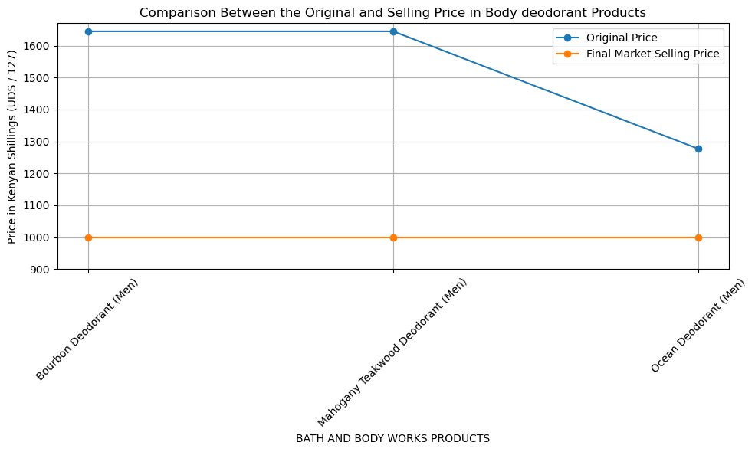
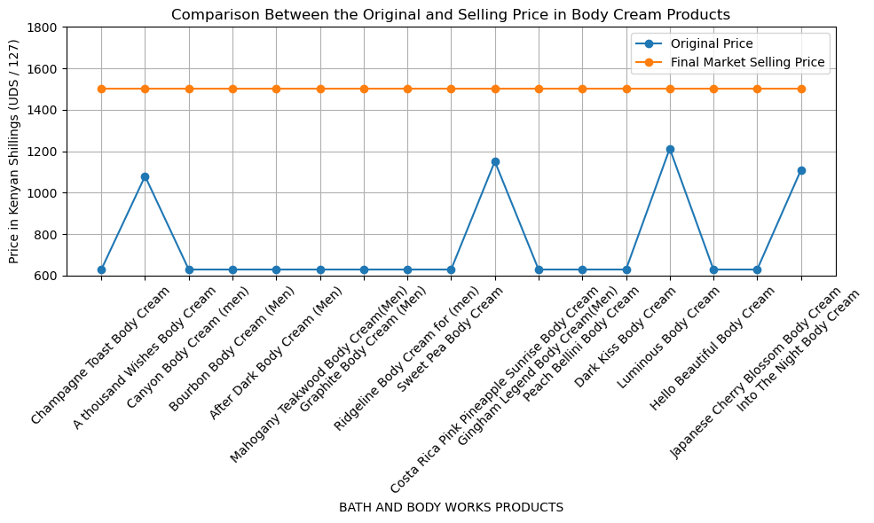
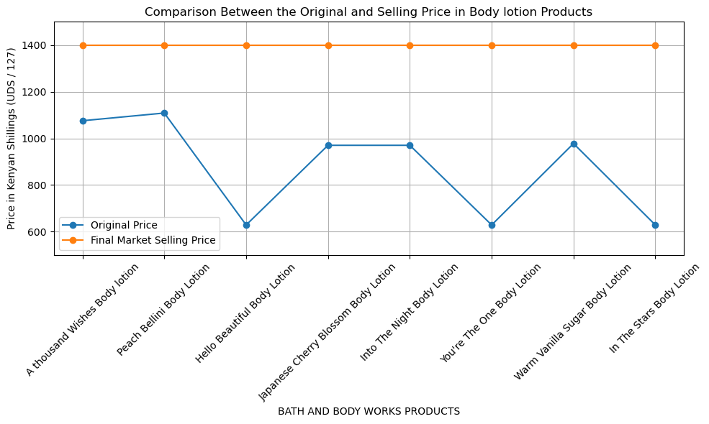
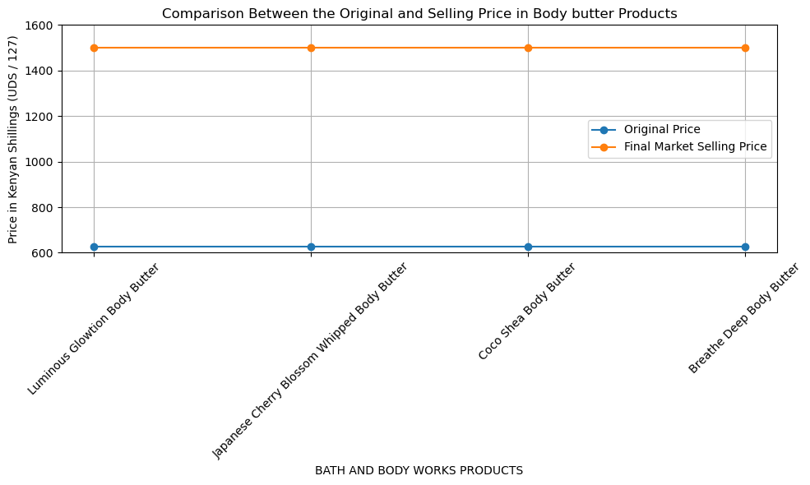

Slide 7
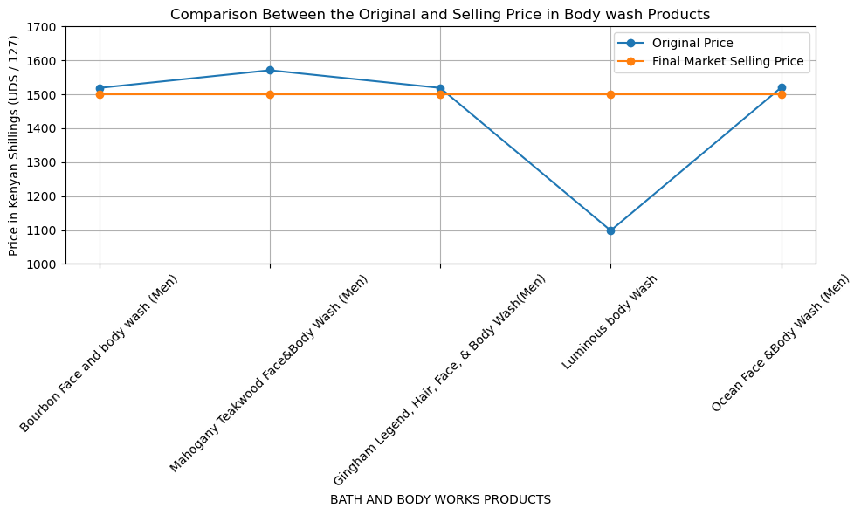
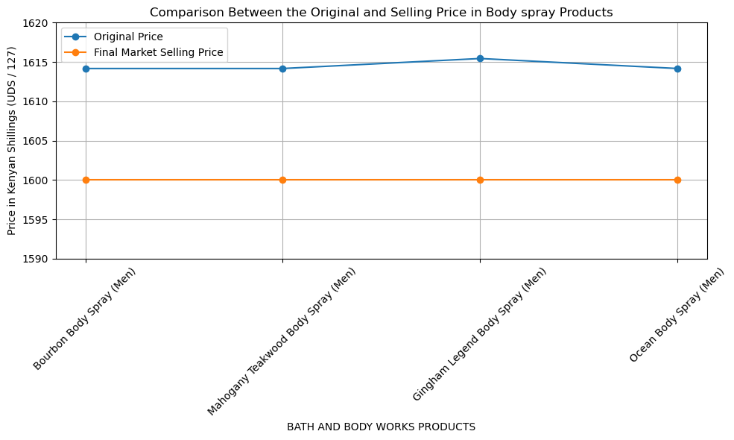
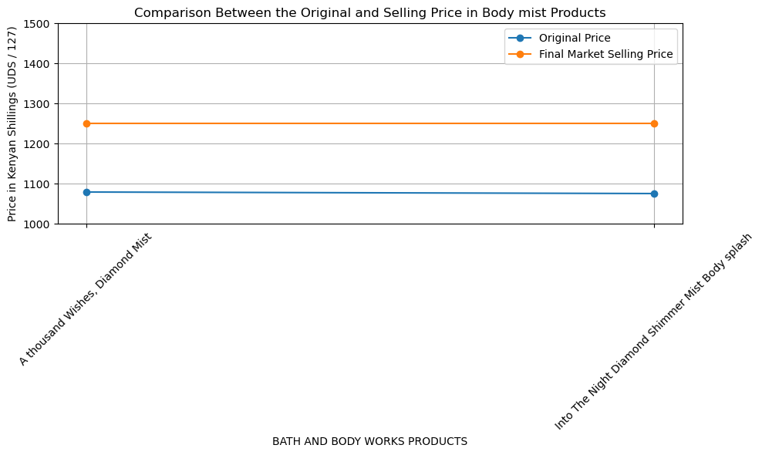
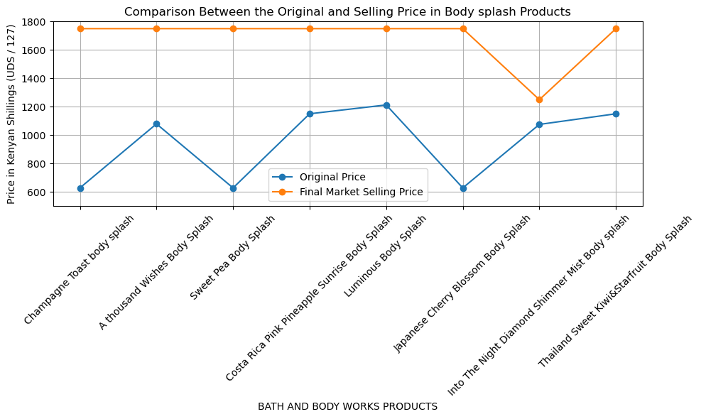

Slide 8
Bath and body cream products =8,859.83
item | Profit | number | total
Champaign toast | 871.35 | 1 | 871.35
A thousand wishes | 420.5 | 2 | 841
Canyon body | 871.35 | 0
Bourbon | 871.35 | 0
After dark | 871.35 | 2
Mahogany teakwood | 871.35 | 1 | 871.35
graphite | 871.35 | 0
ridgeline | 871.35 | 0
Sweet pea | 871.35 | 2 | 1742.7
Costa rica pink pinneple | 349.38 | 1 | 349.38
Gingham legend | 871.35 | 0
Peach bellin | 871.35 | 1 | 871.35
Dark kiss | 871.35 | 1 | 871.35
Luminous | 287.15 | 0
Hello beautiful | 871.35 | 0
Japanese cherry blossom | 871.35 | 1 | 871.35
Into the night | 391.29 | 0
total |  |  | 8,859.83

Slide 9
Bath and body splash products =6,044.73
item | profit | number | Total
Champagne toast | 1121.35 | 1 | 1121.35
A thousand wishes | 670.5 | 1 | 670.5
Sweet pea | 1121.35 | 1 | 1121.35
Coast rica pink | 599.37 | 1 | 599.37
Luminous | 537.14 | 1 | 537.14
Japanese cherry blossom | 1121.35 | 1 | 1121.35
Into the night | 274.30 | 1 | 274.30
Thailand sweet kiwi | 599.37 | 1 | 599.37
total |  |  | 6,044.73

Slide 10
Bath and body mist products =515.31
item | profit | number | Total
A thousand wishes | 170.5 | 2 | 341
Into the night diamond shimer | 174.31 | 1 | 174.31
Total |  |  | 515.31

Slide 11
Bath and body lotion products =4,683.63
item | profit | number | Total
A thousand wishes | 324.31 | 1 | 324.31
Peach belin | 291.29 | 0
Hello beautiful | 771.35 | 2 | 1542.7
Japanese cherry blossom | 429.72 | 0
Into the night | 429.72 | 1 | 429.72
You’re the one | 771.35 | 1 | 771.35
Warm vanila sugar | 422.1 | 2 | 844.2
In the stars | 771.35 | 1 | 771.35
Total |  |  | 4,683.63

Slide 12
Bath and body wash products =-70.99
item | profit | number | Total
Bourbon | -18.92 | 0
Mahogany teakwood | -70.99 | 1 | -70.99
Gingham legend | -18.92 | 0
Luminous body wash | 401.45 | 0
Ocean | -20.19 | 0
Total |  |  | -70.99

Slide 13
Bath and body spray products =-57.95
item | profit | number | Total
Bourbon | -14.17 | 1 | -14.17
Mahogany teakwood | -14.17 | 1 | -14.17
Gingham legend | -15.44 | 1 | -15.44
Ocean | -14.17 | 1 | -14.17
Total |  |  | -57.95

Slide 14
Bath and body deodorant products =-2,210.3
item | profit | number | Total
Bourbon | -644.65 | 2 | -1,289.3
Mahogany teakwood | -644.65 | 1 | -644.65
Ocean | -276.35 | 1 | -276.35
Total |  |  | -2,210.3

Slide 15
Bath and body butter products =3,485.4
item | profit | number | Total
Luminous glowlotion | 871.35 | 0
Japanese cherry blossom | 871.35 | 2 | 1742.7
Coco shea | 871.35 | 1 | 871.35
Breath deap | 871.35 | 1 | 871.35
total |  |  | 3,485.4

Slide 16
item | Profit
Cream products | 9,032.53
Splash prouducts | 6,044.73
Mist poducts | 515.31
Lotion products | 4,683.63
Bodywash products | -70.99
Deodorant products | -2,210.3
Butter products | 3,485.4
total | 21,480.31

Slide 17

Total profit made from this shipment = 19,737.61

Slide 18
Objective 2: Identify High-Profit Products:

Slide 19
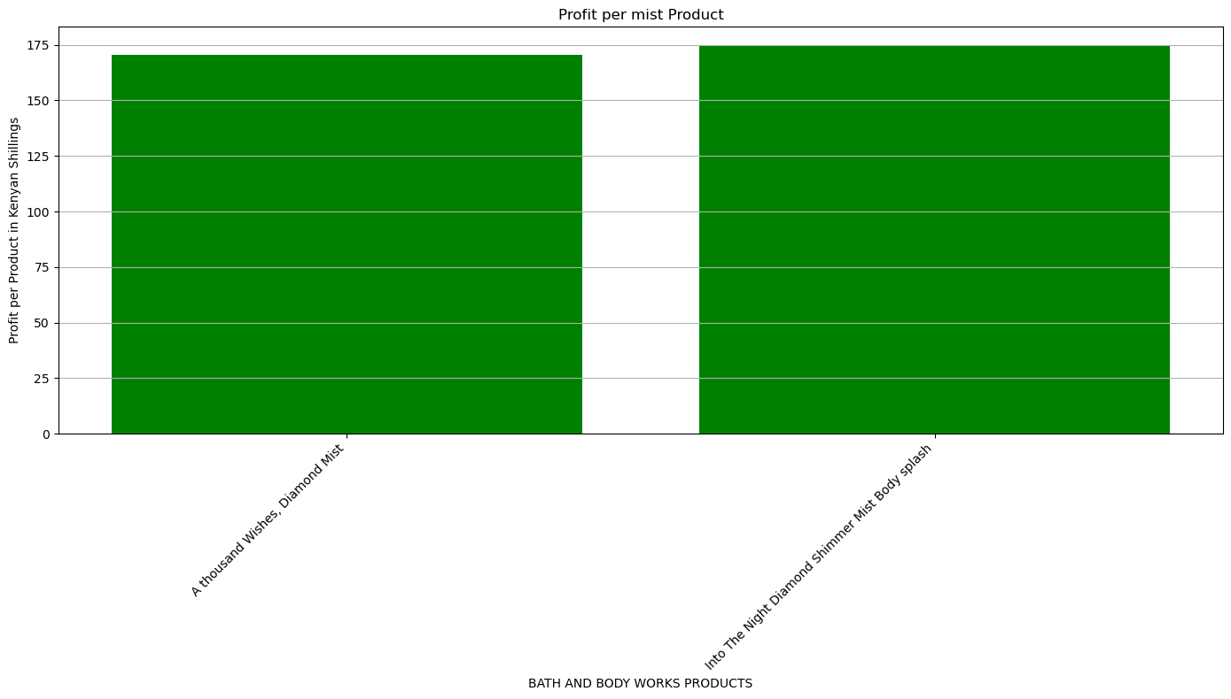
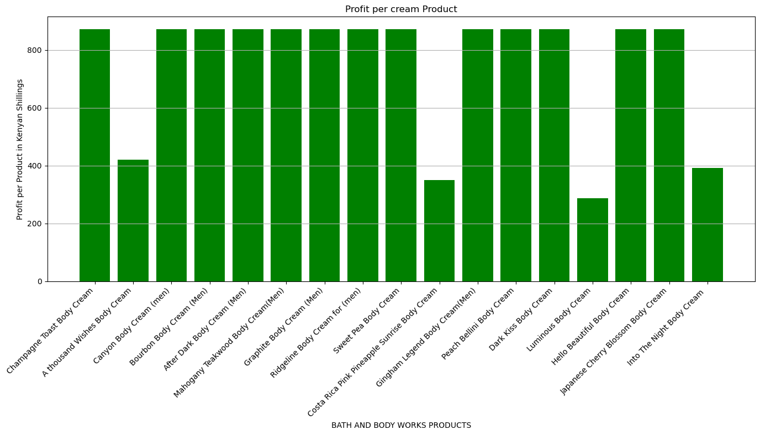
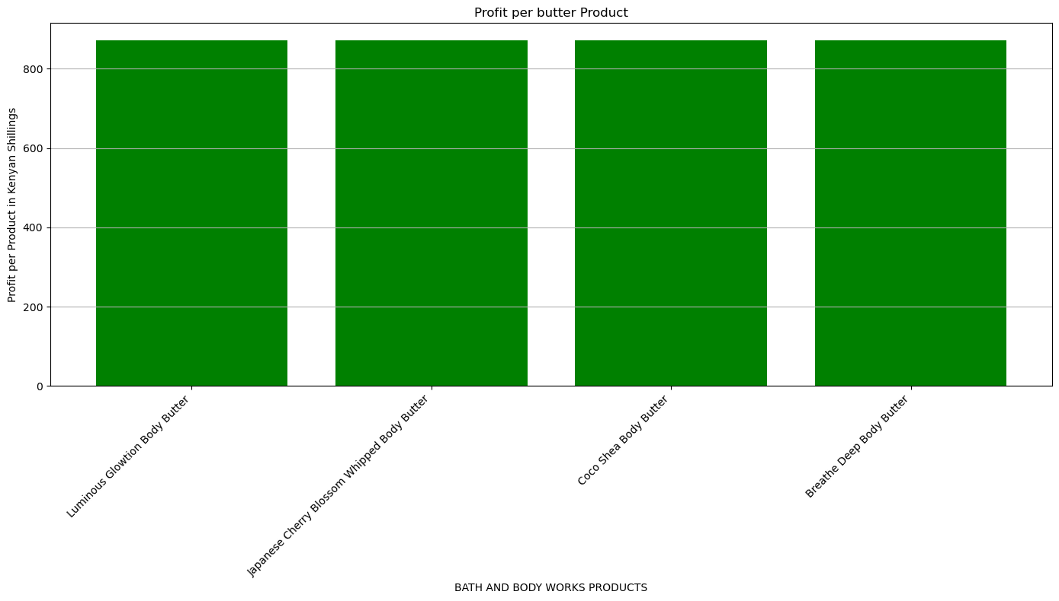
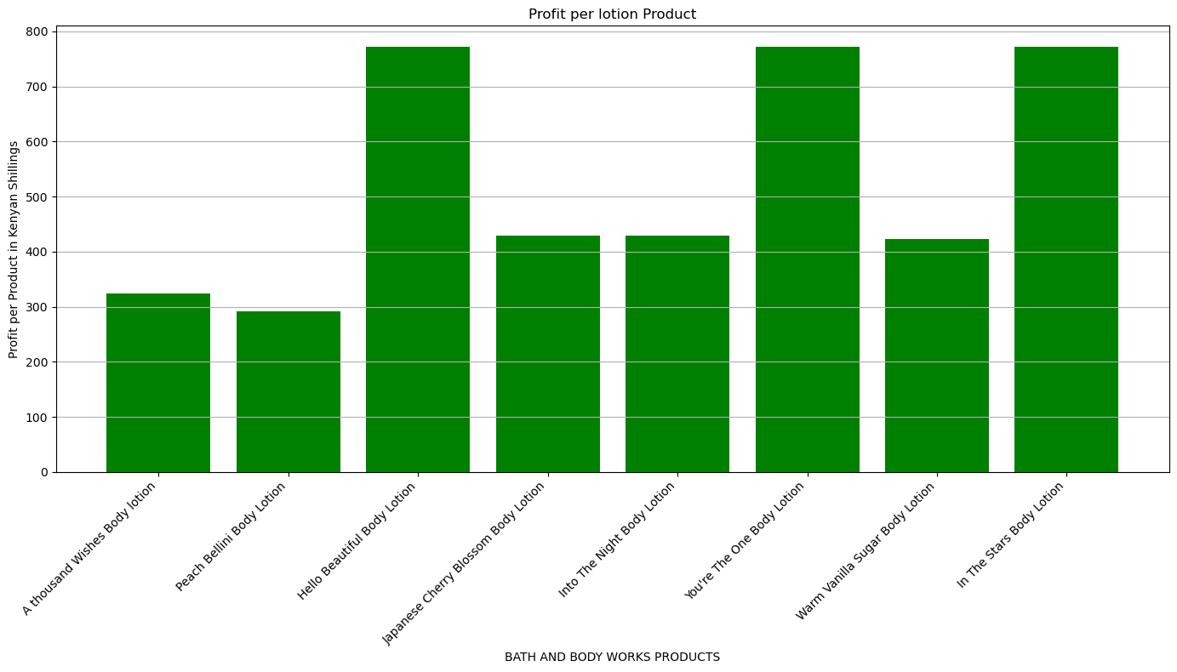

Slide 20
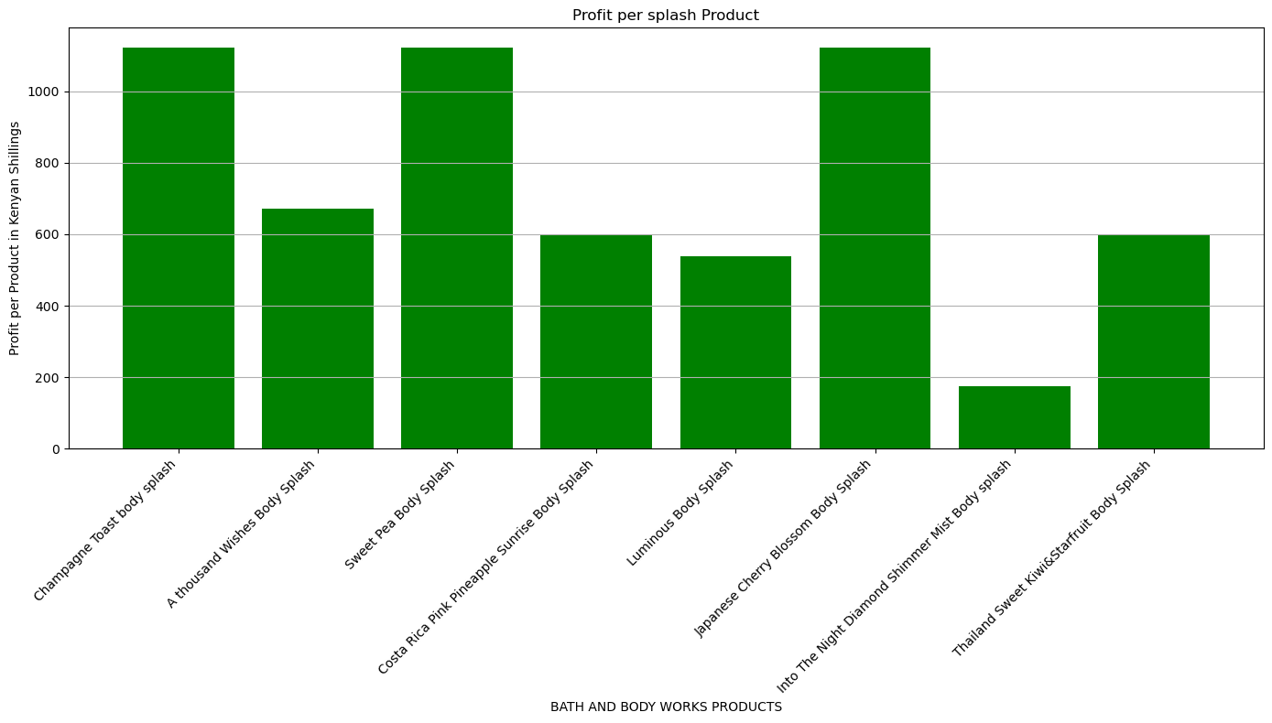

Slide 21
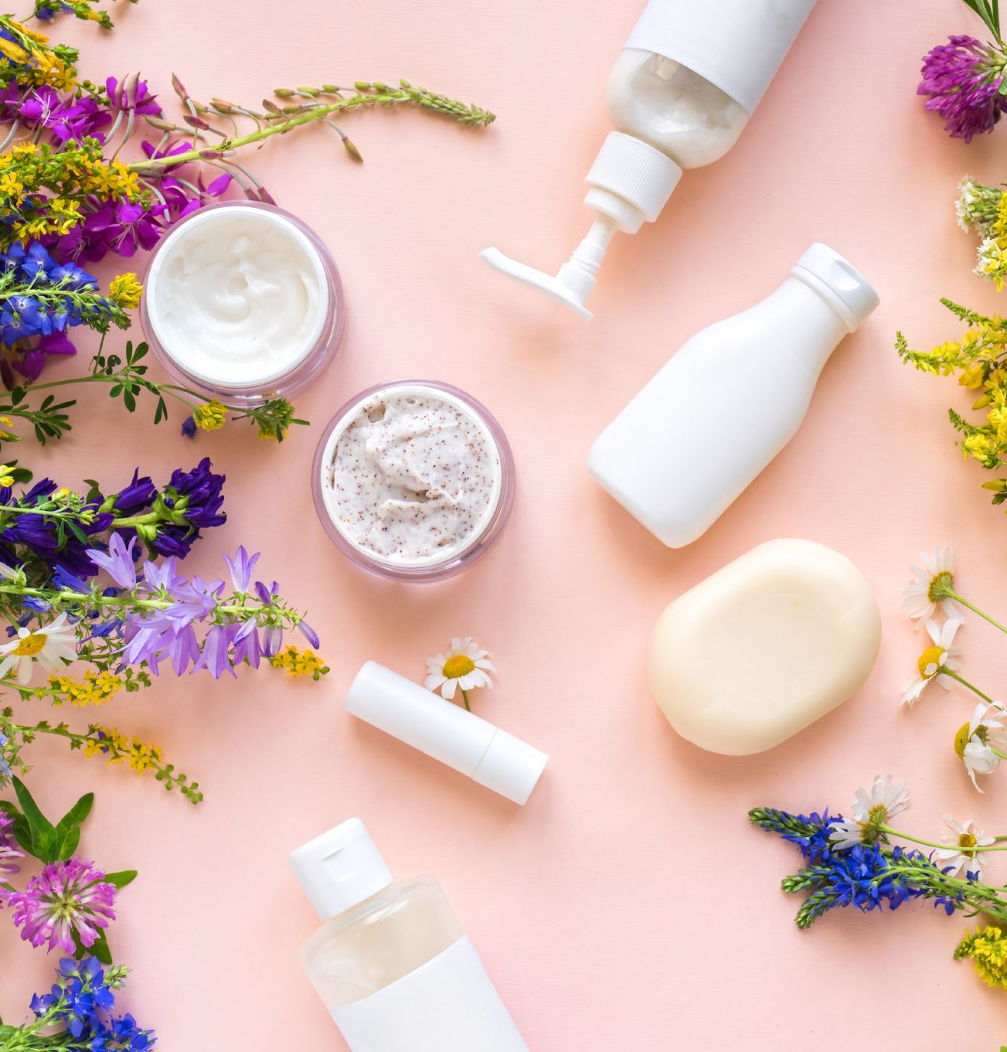
Based on this analysis, we observed the following profit trends among different product categories:
1.Body Cream Products: More than three-quarters of body cream products generate a profit exceeding KSh 800.
2.Body Splash Products: Approximately one-third of body splash products have profits above KSh 1,100.
3.Butter Products: All butter products achieve profits above KSh 800.
4.Lotion Products: One-third of lotion products have profits exceeding KSh 800.
5.Mist Products: All mist products consistently yield a profit of KSh 150.
This analysis highlights the varying profitability across different product lines, providing crucial insights for strategic decision-making and resource allocation.

Slide 22

Objective 3:Analyze Sales Performance:

Slide 23
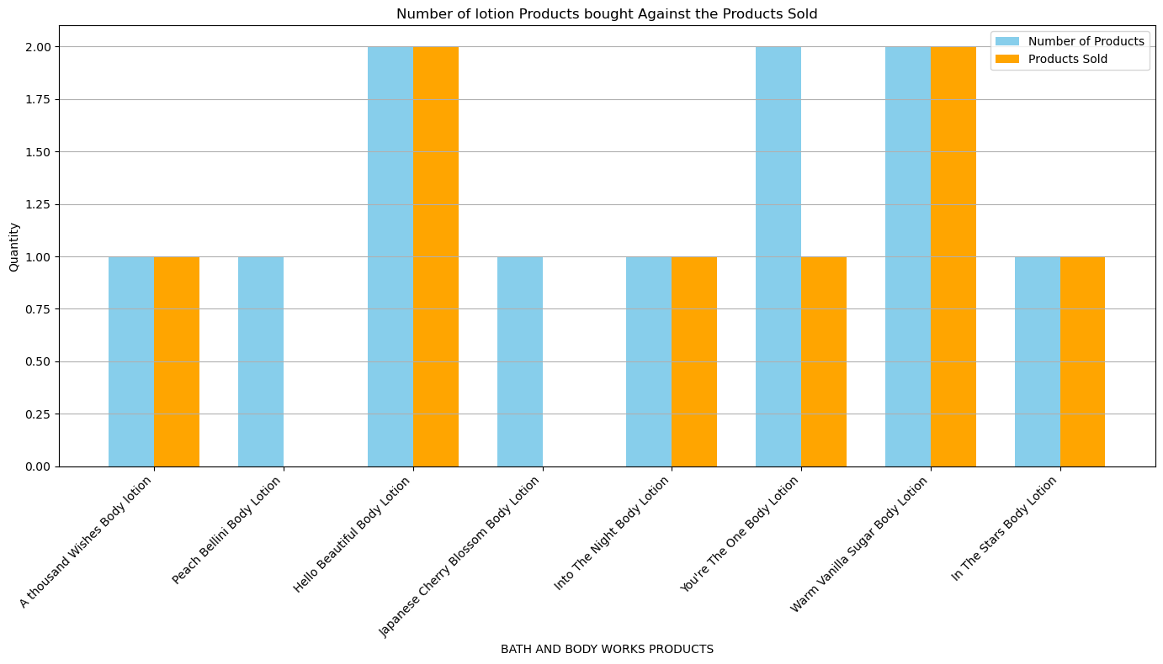
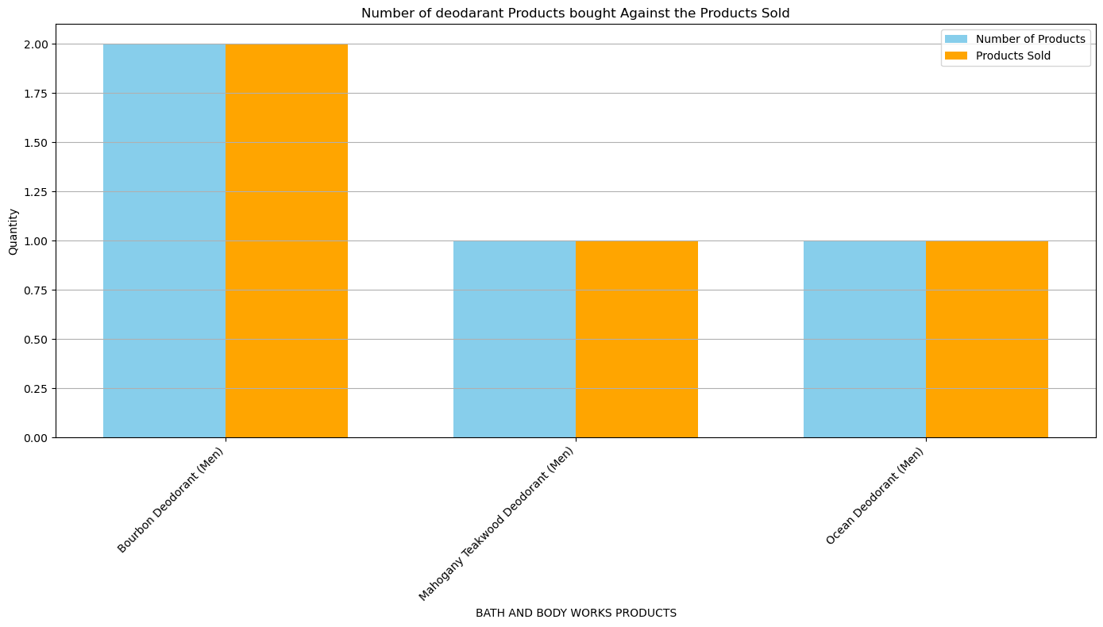
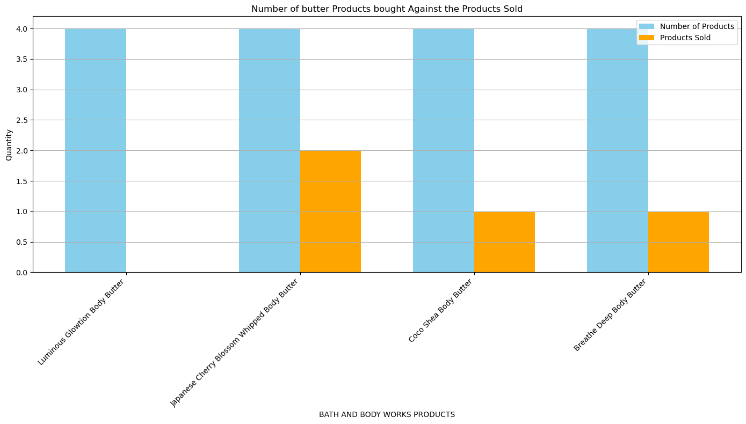

Slide 24
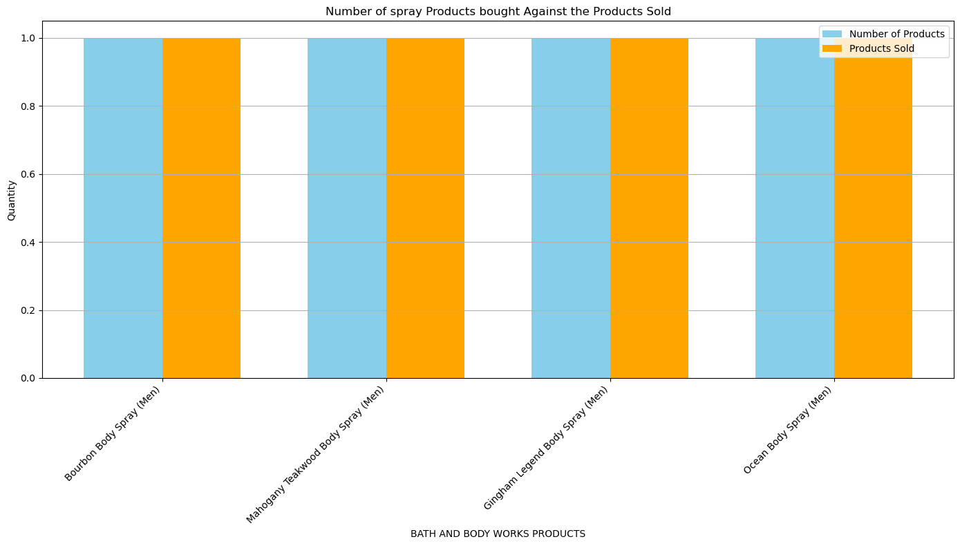
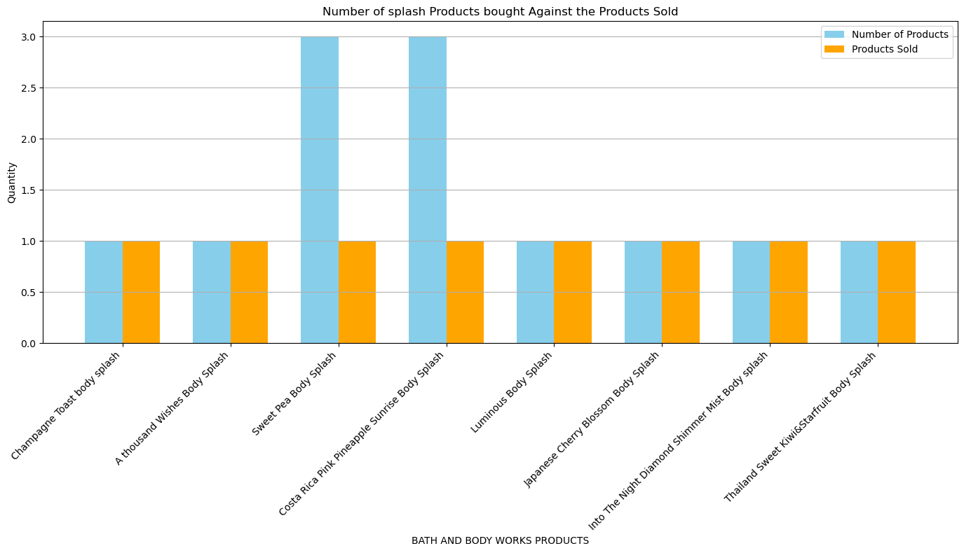
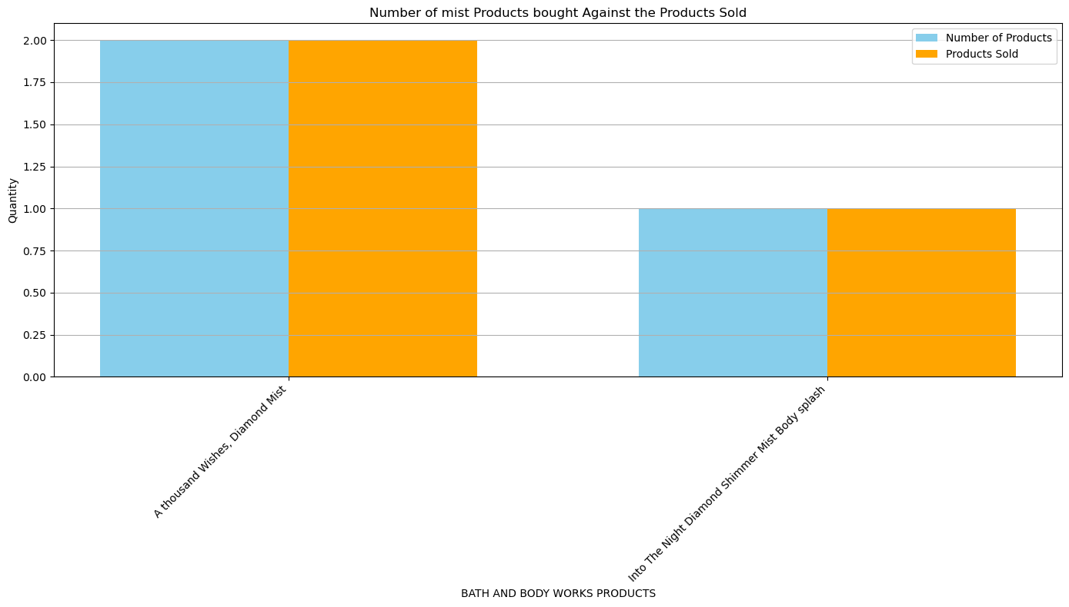
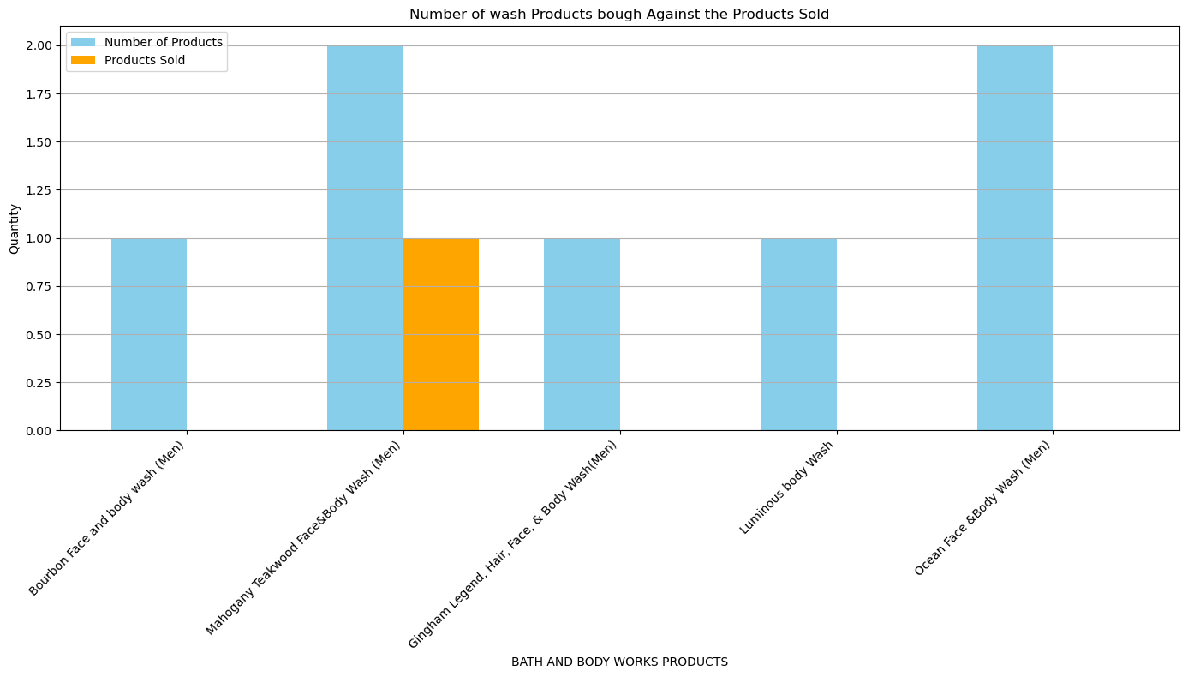

Slide 25
Sales Performance Analysis Splash Products: Sold: 8 out of 12 products Sales Rate: 67% Analysis: Splash products have a relatively high sales rate, indicating strong customer demand. Spray Products: Sold: 4 out of 4 products Sales Rate: 100% Analysis: All spray products are sold, showing they are extremely popular and in high demand. Wash Products: Sold: 1 out of 7 products Sales Rate: 14% Analysis: Wash products have the lowest sales rate, indicating they are less popular and may require reevaluation. Mist Products: Sold: 3 out of 3 products Sales Rate: 100% Analysis: All mist products are sold, reflecting their high popularity and strong market performance. Lotion Products: Sold: 8 out of 11 products Sales Rate: 73% Analysis: Lotion products have a good sales rate, indicating a strong market presence and customer preference. Deodorant Products: Sold: 4 out of 4 products Sales Rate: 100% Analysis: All deodorant products are sold, highlighting their high demand and customer satisfaction. Butter Products: Sold: 4 out of 16 products Sales Rate: 25% Analysis: Butter products have a low sales rate, suggesting they may not be meeting customer expectations. Cream Products: Sold: 10 out of 30 products Sales Rate: 39% Analysis: Cream products have a moderate sales rate, indicating room for improvement in their market penetration.

Slide 26
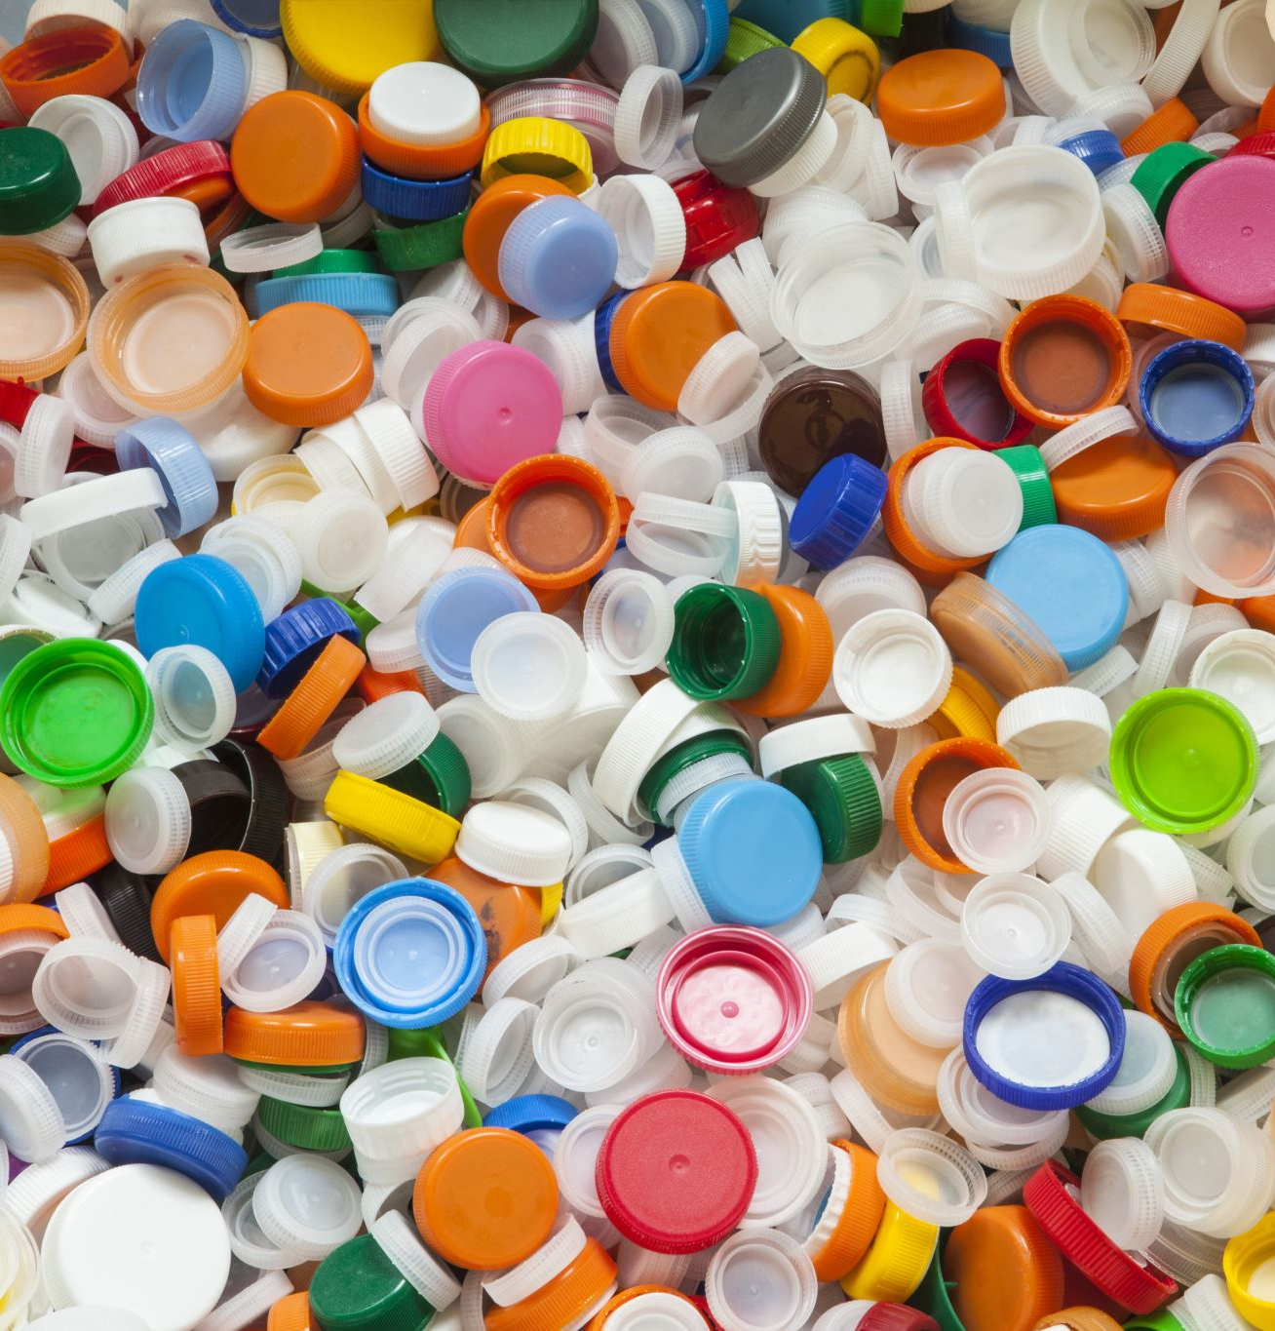
Objective 4:dentify Loss-Making Products:

Slide 27
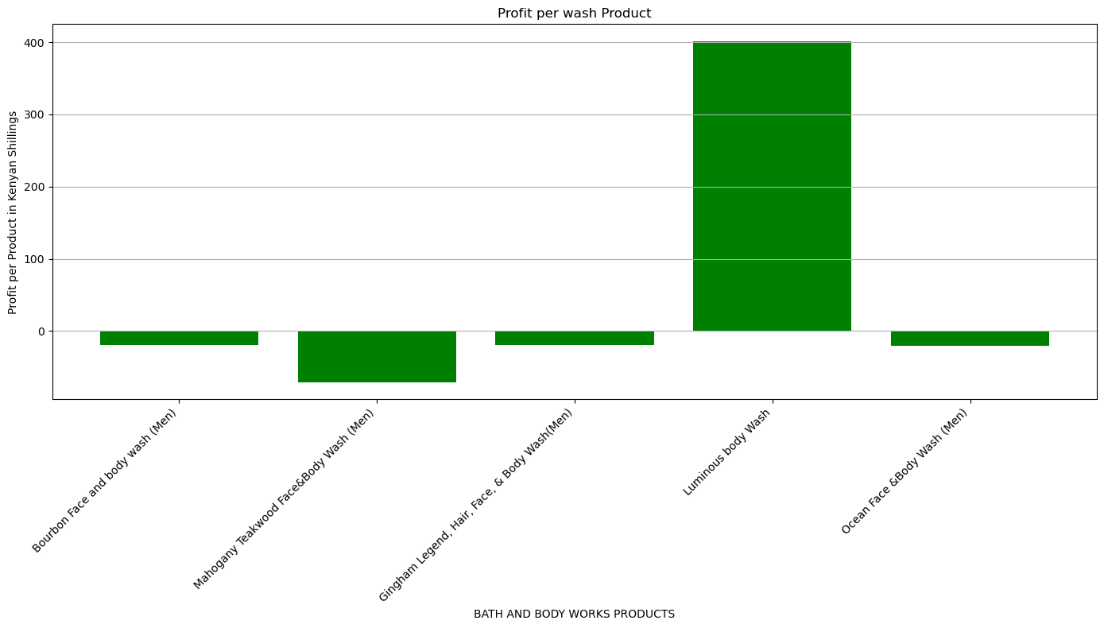
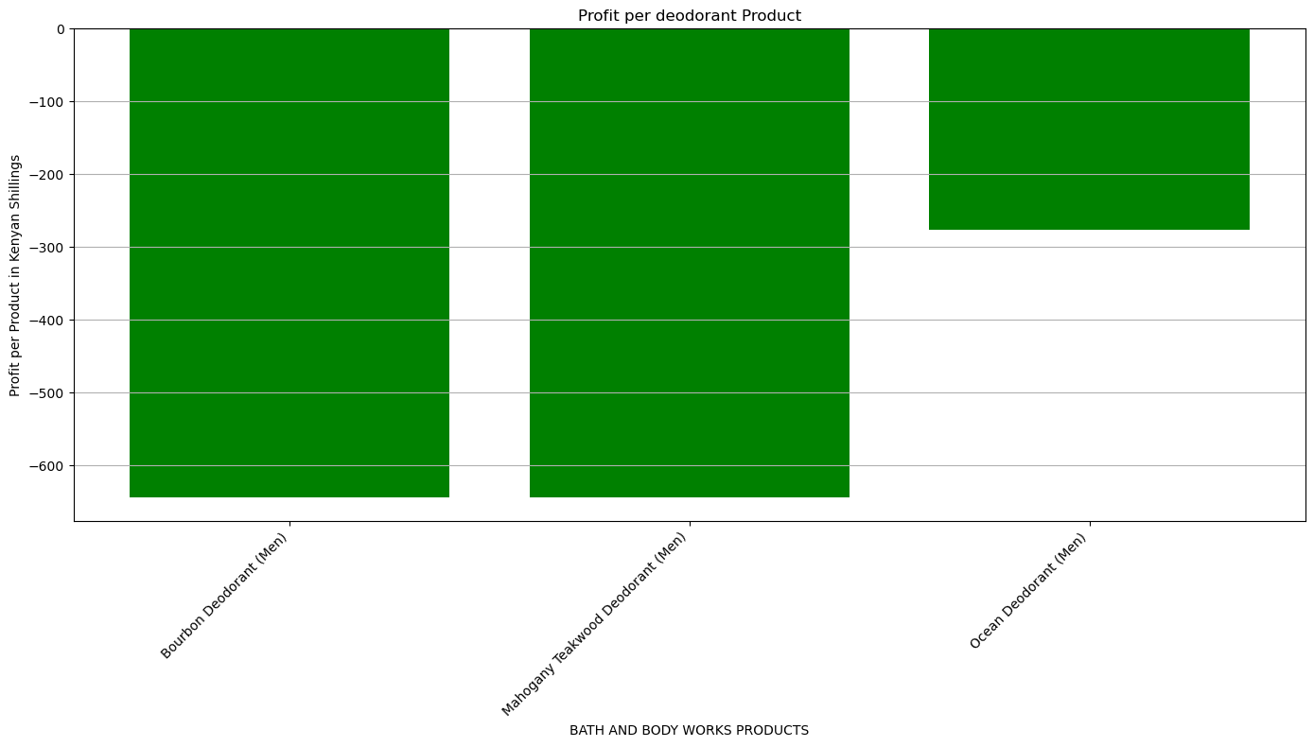
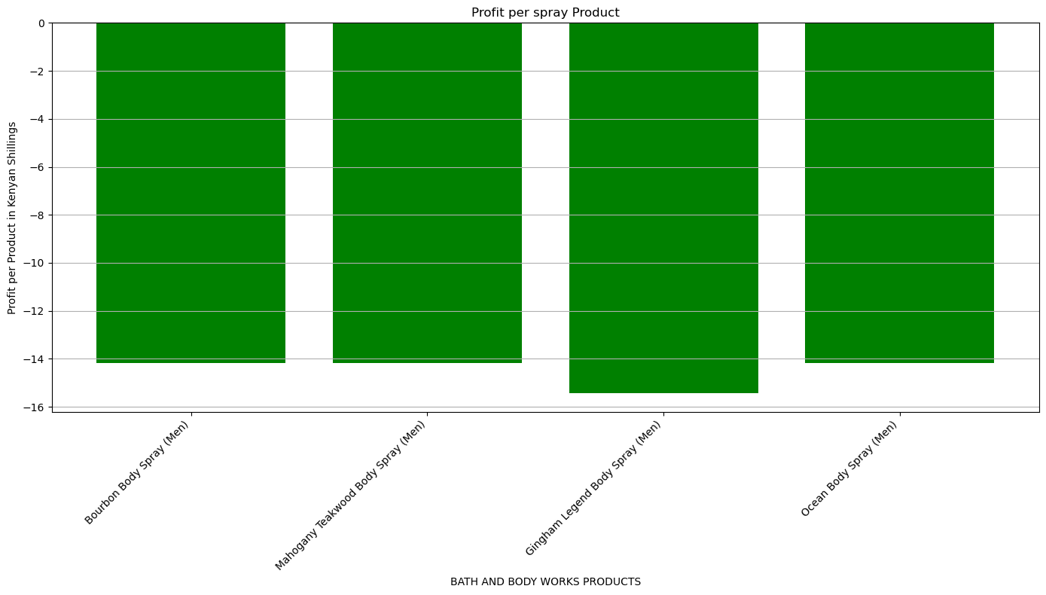

Slide 28
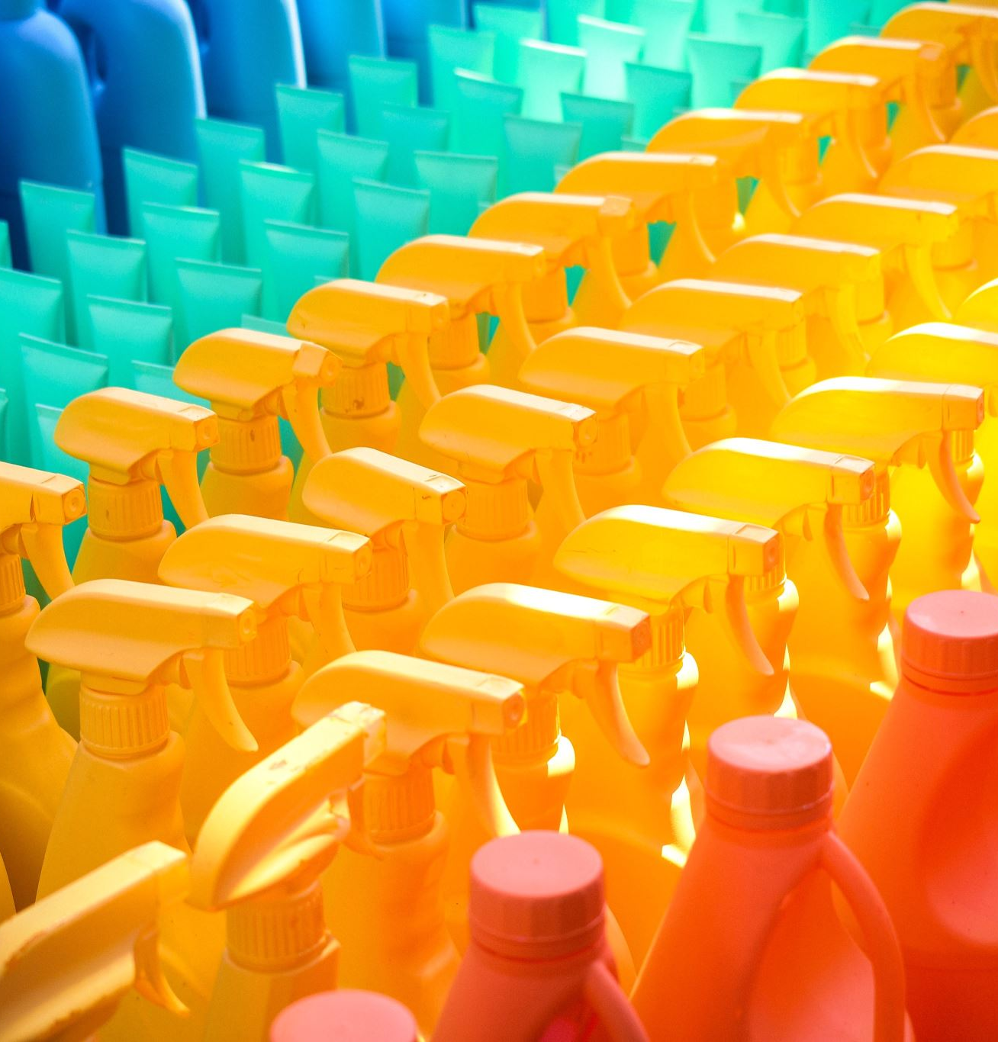
Deodorant Products: Loss Summary: 2 out of 3 deodorant products incur losses exceeding KSh 600. High Loss Rate: The majority (66.7%) of deodorant products are generating significant losses. This suggests underlying issues such as pricing, production costs, or low market demand. Spray Products: Loss Summary: All 4 spray products incur a uniform loss of KSh 14 each. Analysis: Consistent Loss: The uniform loss across all spray products indicates a systemic issue, possibly linked to production costs, pricing strategy, or market positioning. LOSS summary :only one body wash product diddint incur a loss only one

Slide 29

Objective 5:Identify best selling products with the highest profit

Slide 30
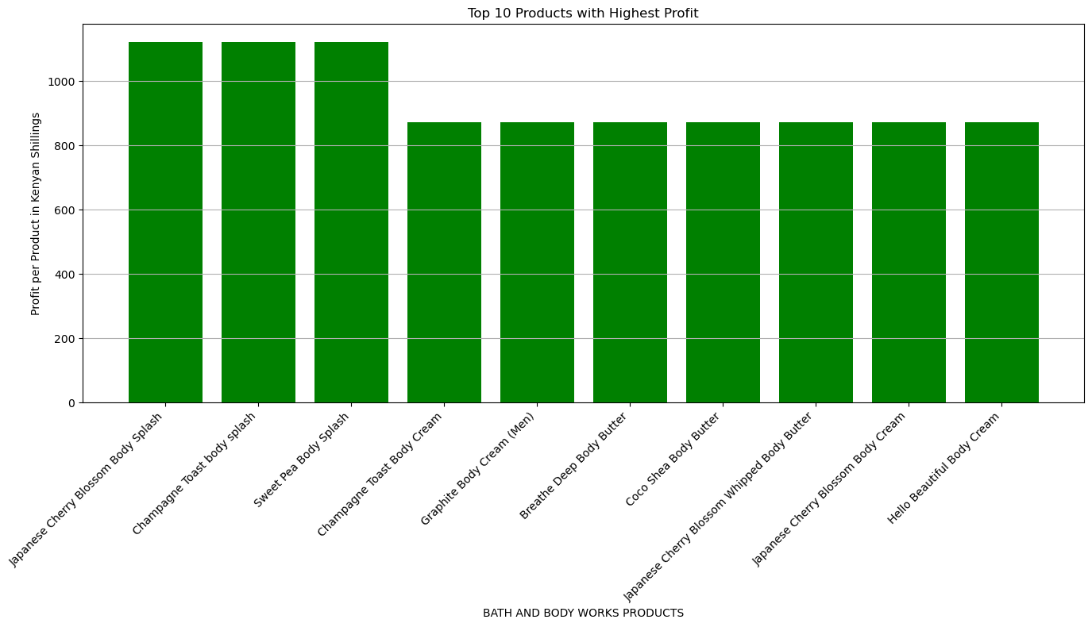
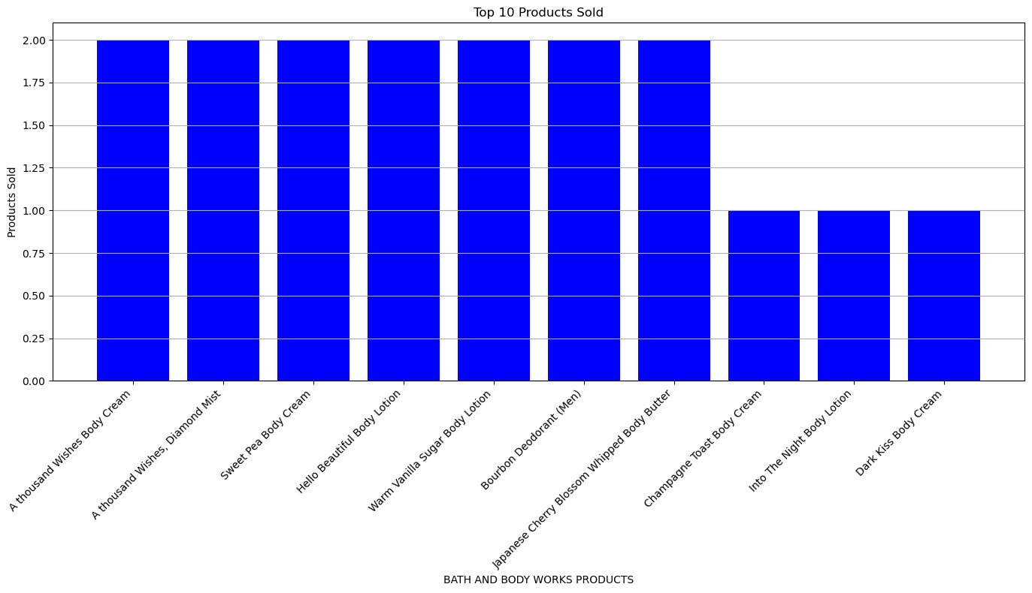

Slide 31
Analysis of Most Profitable and Most Sold Items Most Profitable Items: Japanese Cherry Blossom Body Splash: Profit > KSh 1,000 Champaign Toast Body Splash: Profit > KSh 1,000 Sweet Pea Body Splash: Profit > KSh 1,000 Champaign Toast Body Cream: Profit = KSh 800 Mahogany Teakwood Body Cream: Profit = KSh 800 Japanese Cherry Blossom Body Cream: Profit = KSh 800 Hello Beautiful Body Cream: Profit = KSh 800 Dark Kiss Body Cream: Profit = KSh 800 Gingham Legend Body Cream: Profit = KSh 800 Sweet Pea Body Cream: Profit = KSh 800 Analysis: High Profitability Across Categories: Both body splash and body cream products exhibit high profitability, with profits exceeding or equaling KSh 1,000. This indicates that these product lines are well-received by customers and contribute significantly to the overall profit margin. Consistent Performance: The consistent profitability of body splash products (Japanese Cherry Blossom, Champaign Toast, Sweet Pea) and body cream products (including Champaign Toast, Mahogany Teakwood, Japanese Cherry Blossom, and others) suggests a strong brand presence and customer loyalty. Most Sold Items: A Thousand Wishes Body Cream: Sold = 2 A Thousand Wishes Body Mist: Sold = 2 Hello Beautiful Body Lotion: Sold = 2 Sweet Pea Body Cream: Sold = 2 Warm Vanilla Body Lotion: Sold = 2 Burbon Deodorant: Sold = 2 Japanese Cherry Blossom Body Butter: Sold = 2 Into the Night Body Lotion: Sold = 1 Into the Dark Body Cream: Sold = 1 Analysis: Top Performers: Several products, such as A Thousand Wishes Body Cream, and Mist, Hello Beautiful Body Lotion, and Sweet Pea Body Cream, have sold well, indicating strong customer preference. Diverse Range: The most sold items span across different product categories including body creams, mists, lotions, deodorants, and butters, highlighting the diverse product preferences among customers. Room for Improvement: Products like Into the Night Body Lotion and Into the Dark Body Cream have lower sales, indicating potential areas for increased marketing efforts or product enhancement.

Slide 32

Objective 6:Provide Strategic Business Recommendations:

Slide 33
Based on the comprehensive analysis of H & J Bath and Body Works products, here are some strategic business recommendations:
Business Recommendations
Enhance Marketing for High-Profit Items:
Promote High-Profit Products: Increase marketing efforts for the top-performing products such as Japanese Cherry Blossom Body Splash, Champaign Toast Body Splash, and Sweet Pea Body Splash. Highlight their benefits and customer satisfaction to attract more buyers.
Utilize Cross-Promotions: Offer bundled promotions that include high-profit items with other products to boost overall sales and customer value.
Revamp Underperforming Products:
Reevaluate Wash and Butter Products: These products have the lowest sales rates. Consider reformulating or rebranding them to better align with customer preferences. Conduct market research to understand why these items are underperforming.
Strategic Discounts and Offers: Implement targeted discounts or promotional campaigns to clear out existing inventory of underperforming products.
Optimize Pricing Strategy:
Adjust Pricing for Loss-Making Items: Review and adjust the pricing strategy for deodorant products, which have significant losses. A minor price increase or cost reduction might make these products profitable.
Uniform Pricing Review: The consistent loss across all spray products suggests the need for a systematic review of production costs and pricing strategies.
Improve Product Appeal and Inventory Management:
Focus on Best Sellers: Products like After Dark Body Cream, A Thousand Wishes Body Cream and Mist, and Hello Beautiful Body Lotion are among the top sellers. Ensure adequate inventory and consider extending these product lines.
Customer Feedback Integration: Use customer insights and feedback to improve existing products and develop new ones that cater to market demand.
Expand Market Reach:
Leverage Online Platforms: Strengthen online presence and e-commerce strategies to reach a broader audience. Optimize SEO, enhance the user experience on your website, and engage with customers through social media.
Explore New Markets: Consider expanding into new geographical regions or partnering with other businesses to increase market penetration.
Increase Customer Engagement:
Loyalty Programs: Implement or enhance loyalty programs to encourage repeat purchases and build a loyal customer base. Offer exclusive deals and rewards to returning customers.
Personalized Marketing: Use data analytics to create personalized marketing campaigns that target specific customer segments based on their buying behavior and preferences.
Operational Efficiency:
Cost Reduction: Regularly review and optimize production and operational costs. Negotiate better terms with suppliers and streamline supply chain processes to improve profit margins.
Efficient Inventory Management: Implement efficient inventory management systems to reduce holding costs and prevent stockouts or overstock situations.
By implementing these strategic recommendations, H & J Bath and Body Works can optimize its product portfolio, enhance customer satisfaction, and achieve sustainable growth and profitability.

Slide 34
THANK YOU
Joseph Nderitu
+2541114192225
josephnderitu2024@gmail.com

